Slide 1
NoIF
https://github.com/franco-melandri

Slide 2
NoIF
Writing code without IF… possible
Notes:
The IF is not an evil
The use of IF without thinking about a different and possible solution is the error
Let me show some examples present in YNAP code base in order to understand the reason why wrong use of IF is evil

Slide 3
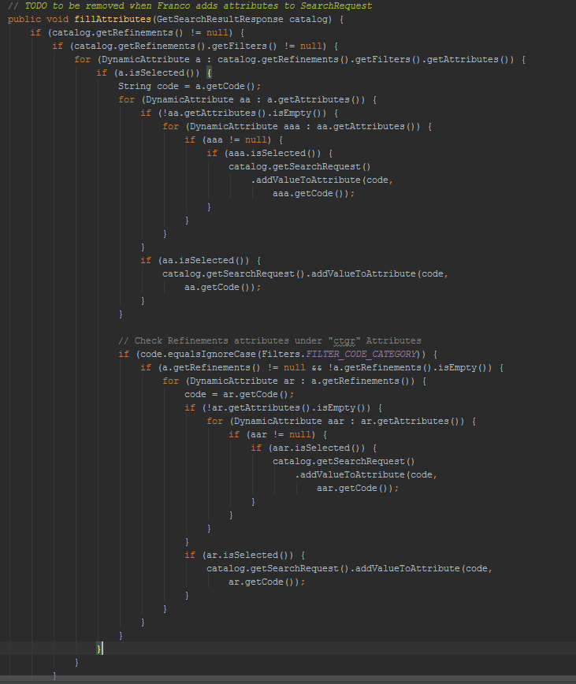
Notes:
YOOX Android app

Slide 4
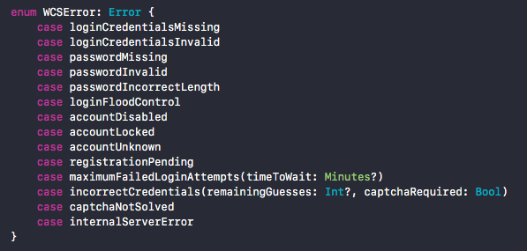
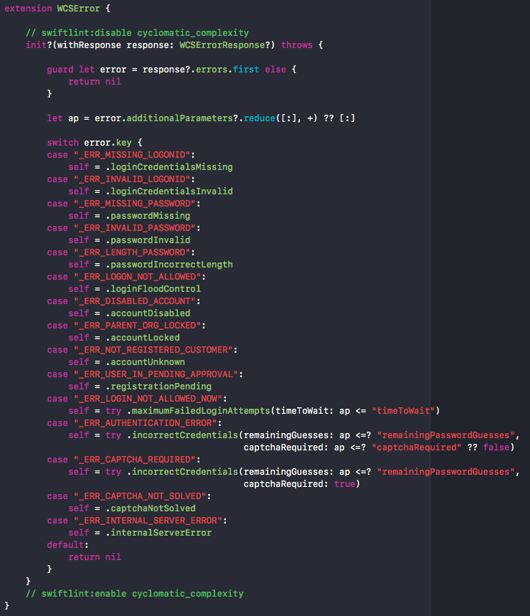
Cyclomatic complexity is a software metric, used to indicate the complexity of a program.
It is a quantitative measure of the number of linearly independent paths through a program's source code.
Notes:
YNSDK iOS Mobile framework

Slide 5
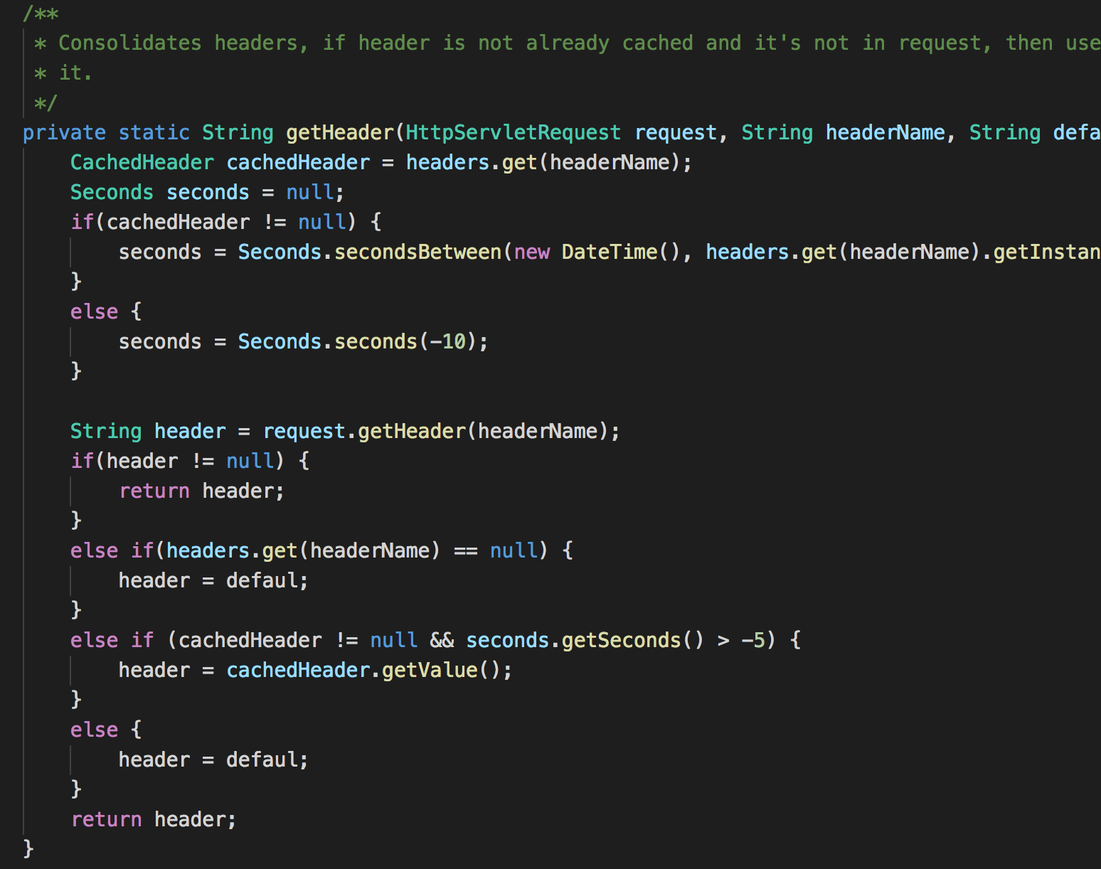
Notes:
WCS platform

Slide 6
What I will speak and coding of …
Analyse six code snippets with IF and SWITCH statements.
Try to approach using a different point of view.
Understand why the new solution is better then the first one.

Slide 7
What I will speak and coding of …
Singleton
Return null
Enums
FizzBuzz
Polymorphism
Visitor

Slide 8
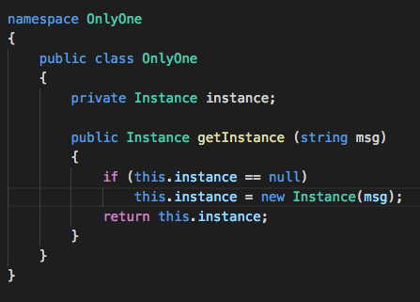
Singleton
Notes:
Every time we call getInstance method we perform an IF statement

Slide 9
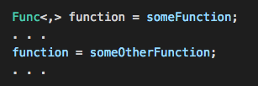
Singleton how to improve your code...
Move into functional world where …
… functions are first-class citizen …
… so I can write something like this

Slide 10
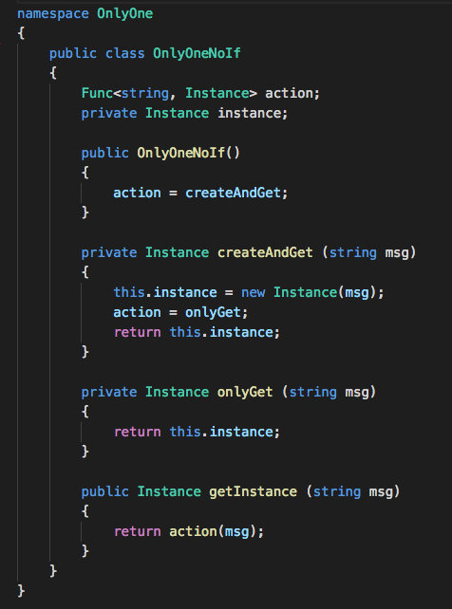
Singleton revisited

Slide 11
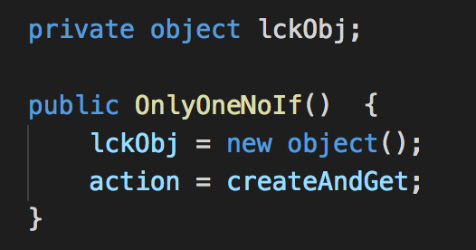
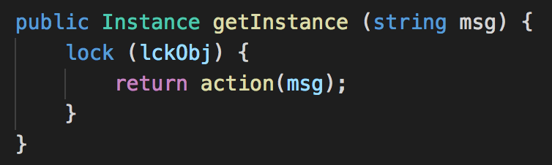
Singleton antipattern …
In case of high concurrency systems …
… we have to protect the method getInstance() …

Slide 12
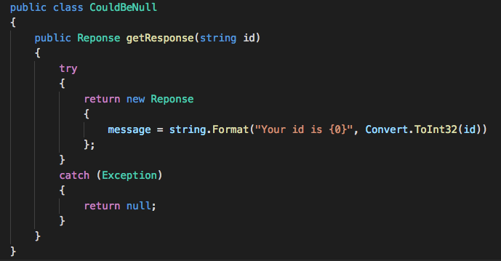
Return null
Notes:
- Sometimes methods return null

Slide 13
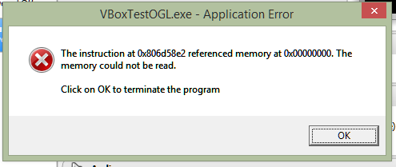
Return null
Tony Hoare invented the null reference in 1965
The billion-dollar mistake…
NULL
null
Nothing
nil
nullptr
undef
None

Slide 14
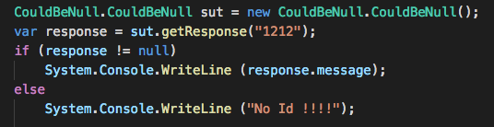
Return null
Client must check the return value …
… to avoid null reference exception

Slide 15
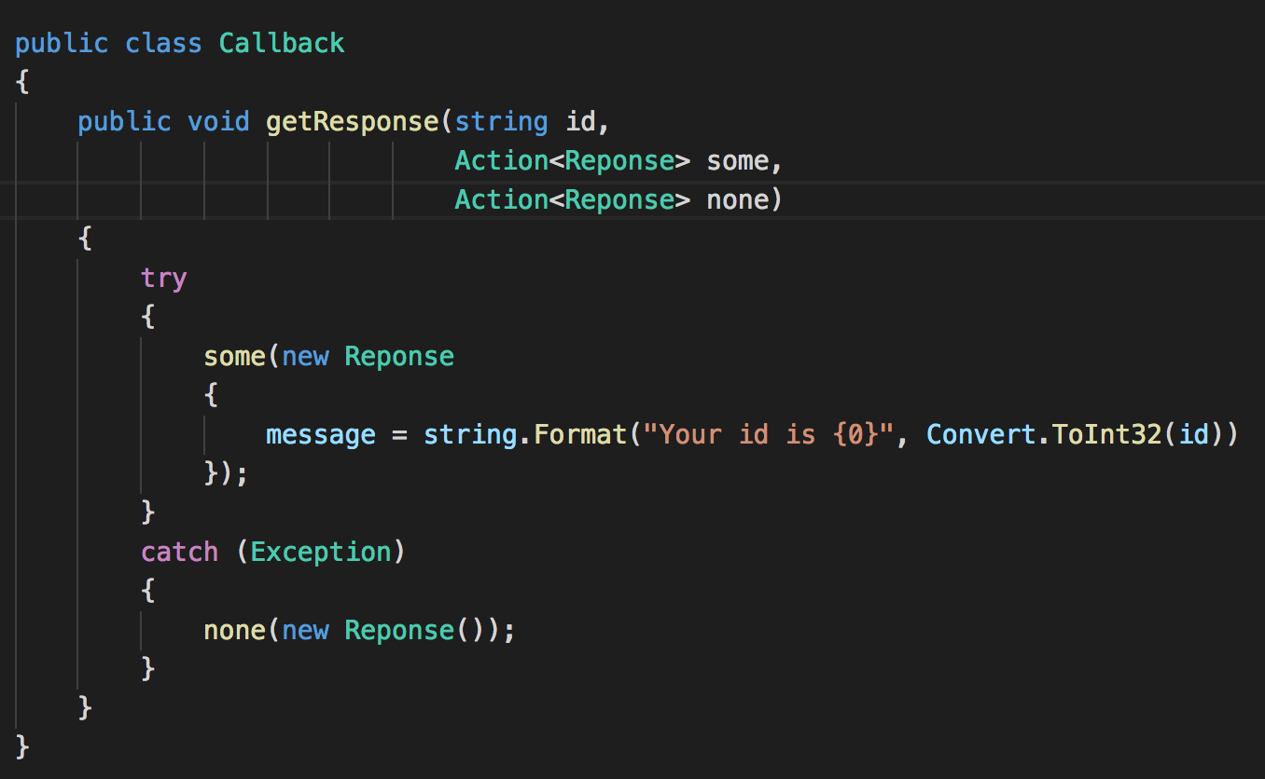
Return null javascript approach using callbacks…
Success callback
No return
Empty
callback

Slide 16
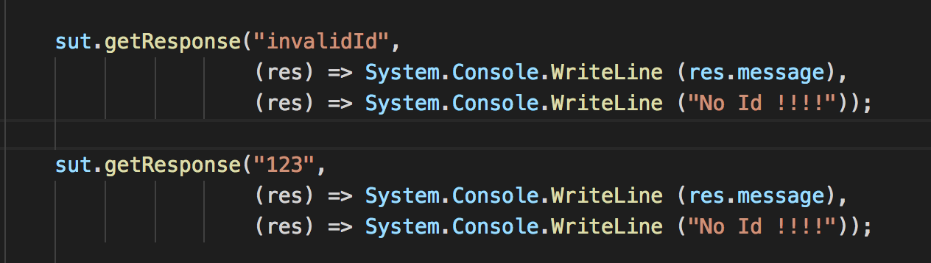
Return null javascript approach from client…
Using callbacks…
… we remove the IF and …
…the code is SAFE

Slide 17
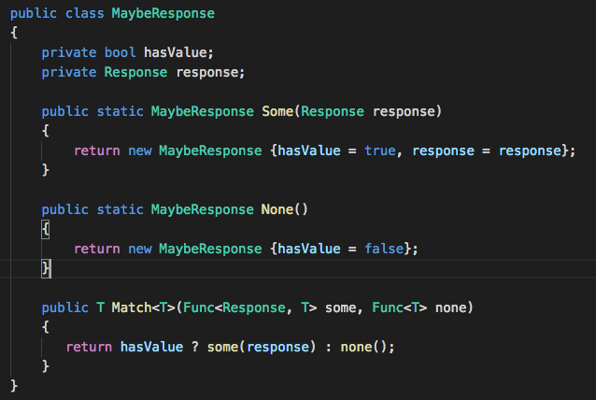
Return null functional approach using maybe monad…

Slide 18
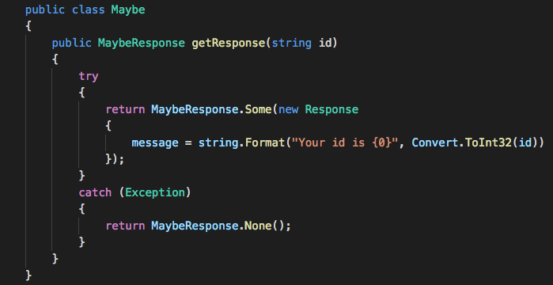
Return null functional approach using maybe monad…
Maybe
Monad

Slide 19
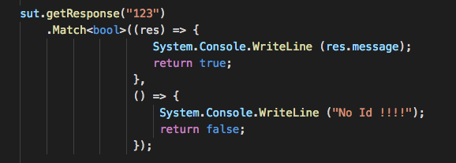
Return null functional approach from client…
Using maybe monad…
… we remove the IF and …
…the code is SAFE

Slide 20
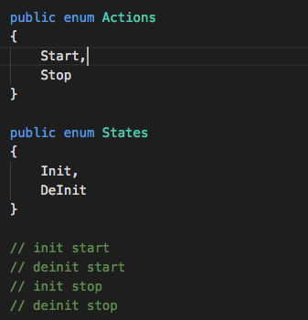
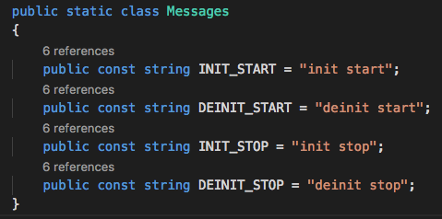
Enums

Slide 21
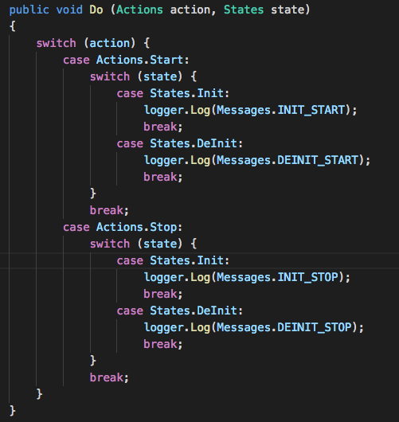
Enums using switch approach…

Slide 22
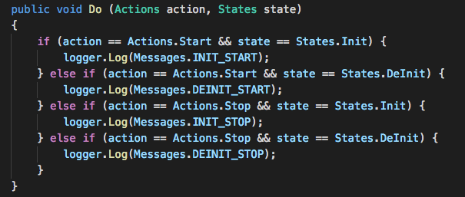
Enums using If approach…

Slide 23
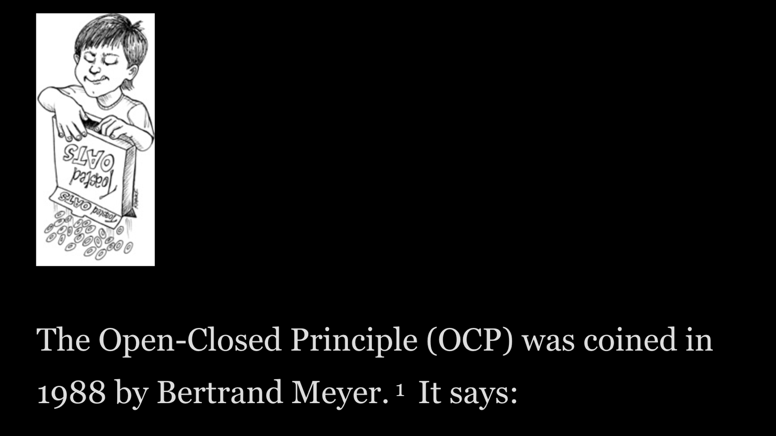
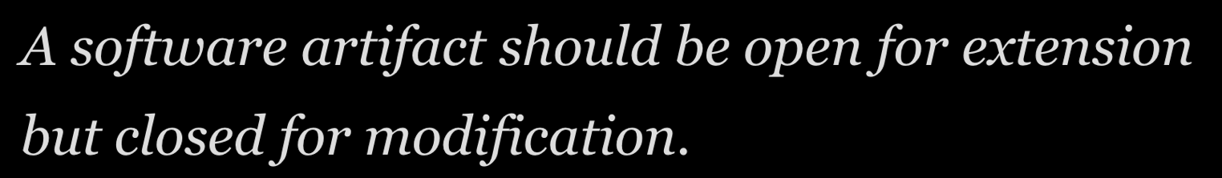
Enums OCP…

Slide 24
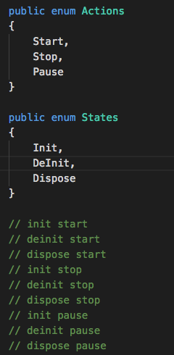
Enums what’s happen if I add some states…

Slide 25
Enums considerations…think different…
For each action and state we have a string to show …
… for each key we have value …
... and the key could be a …
… FUNCTION

Slide 26
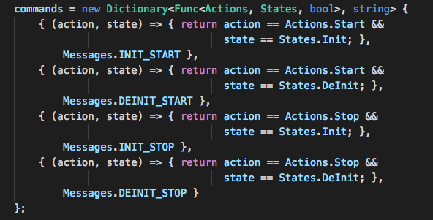
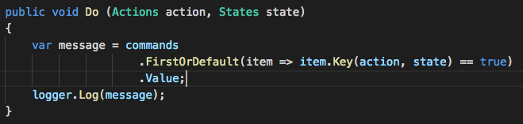
Enums at the end …

Slide 27
Fizz Buzz
Given an integer number as input
Return fizz if the number is divisible by 3
Return buzz if the number is divisible by 5
Return fizzbuzz if the number is divisible by 3 and 5
1,2,fizz,4,buzz,fizz,7,8,fizz,buzz,11,fizz,13,14,fizzbuzz,…

Slide 28
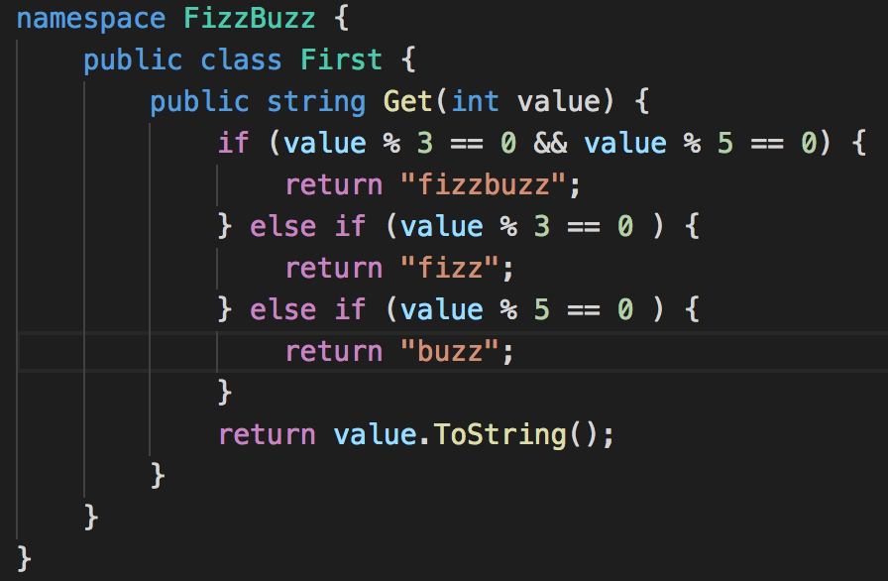
Fizz Buzz … the basic way …

Slide 29
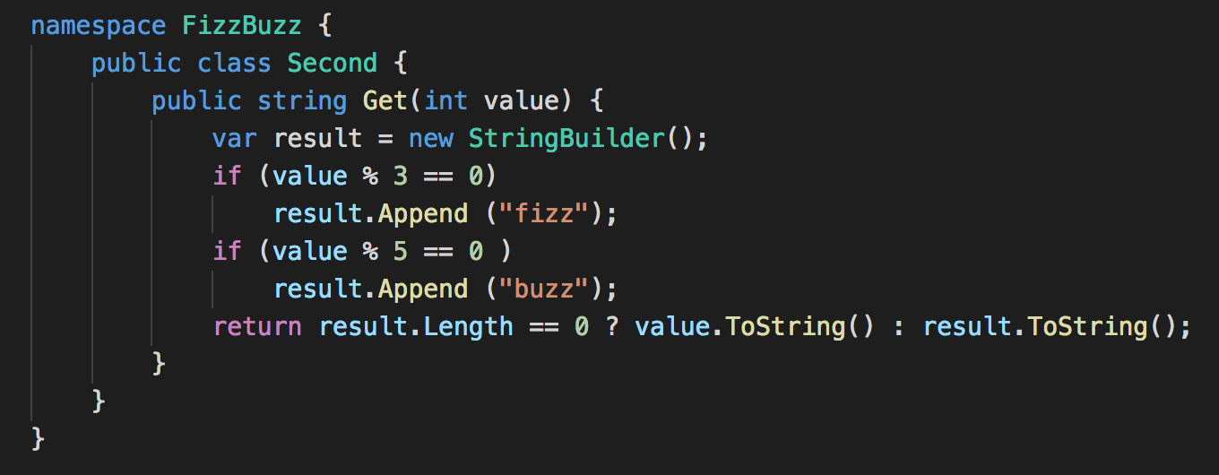
Fizz Buzz … improving the If …

Slide 30
Fizz Buzz …and now something change …
Return pazz if the number is divisible by 7
Return fizzpazz if the number is divisible by 3 and 7
Return buzzpazz if the number is divisible by 5 and 7
Return fizzbuzzpazz if the number is divisible by 3, 5 and 7
?
What happen to your previous code

Slide 31
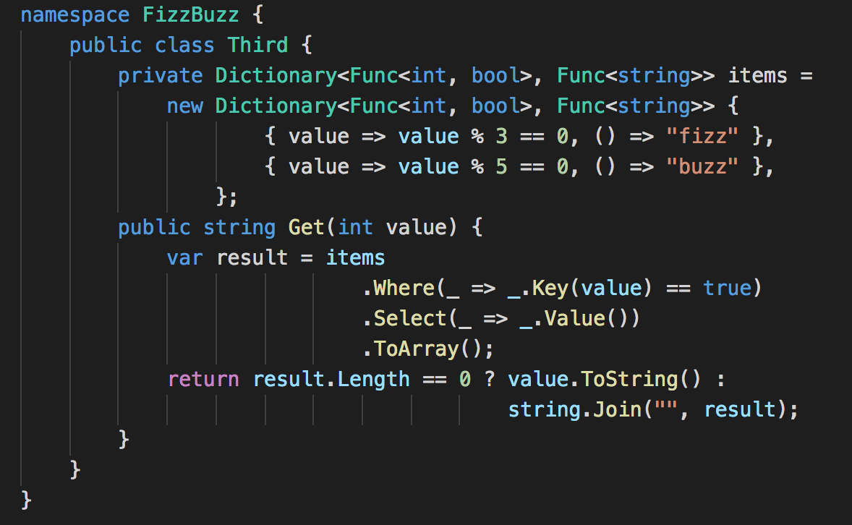
Fizz Buzz … the right way …

Slide 32
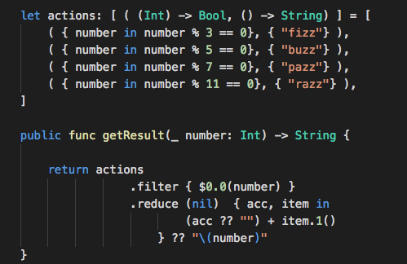
Fizz Buzz …for swift lovers…fully functional

Slide 33
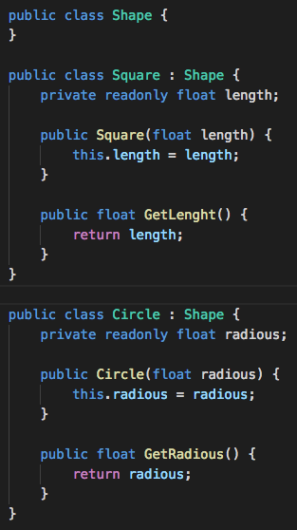
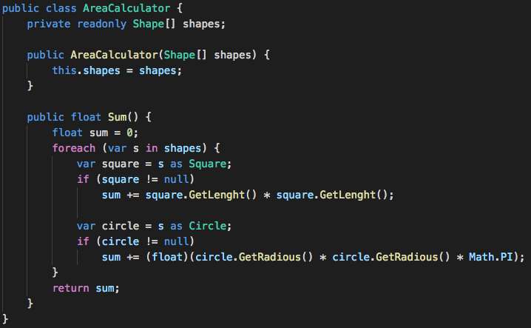
Polymorphism

Slide 34


Polymorphism…design error…

Slide 35
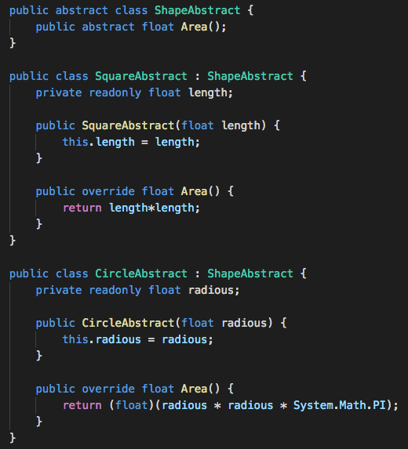
Polymorphism…the abstract way…

Slide 36
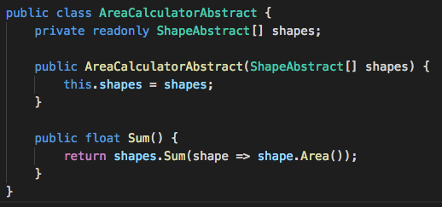
Polymorphism…the abstract way…

Slide 37
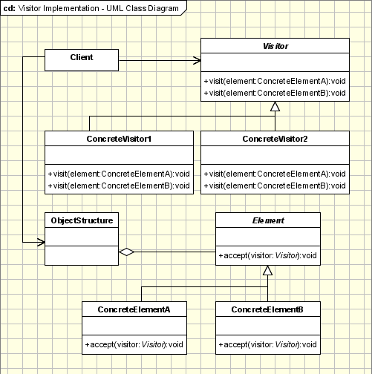
Visitor … the unknown design pattern …

Slide 38
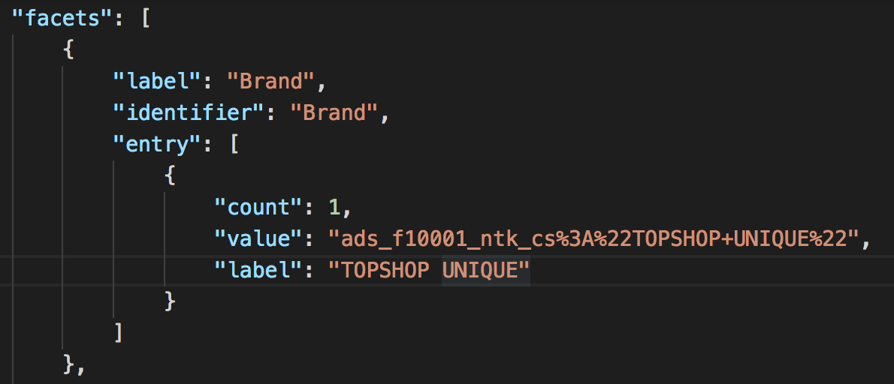
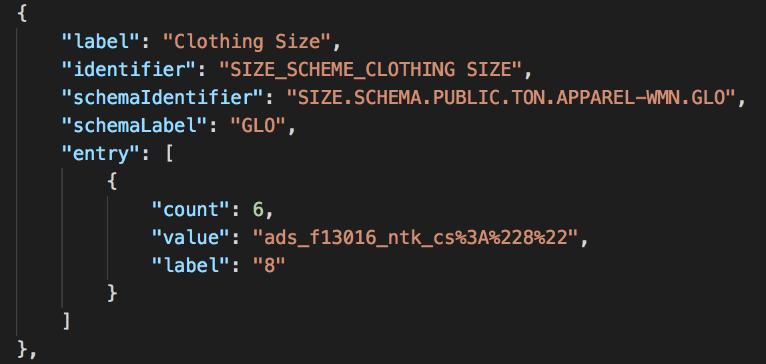
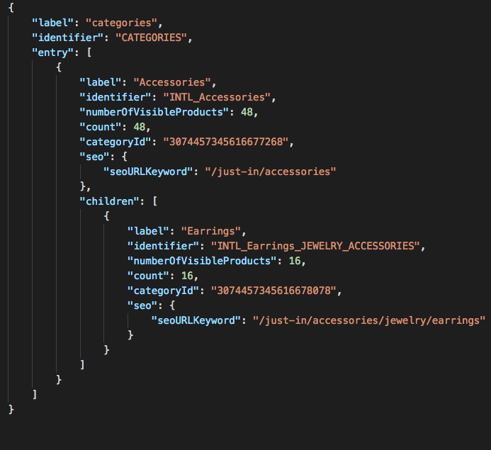
Visitor … a concrete example … in our WCS magic world!

Slide 39
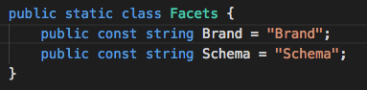
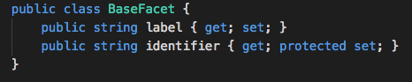
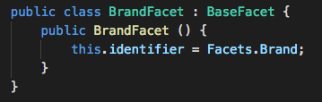
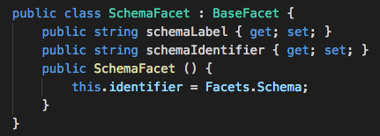
Visitor …the basic way

Slide 40
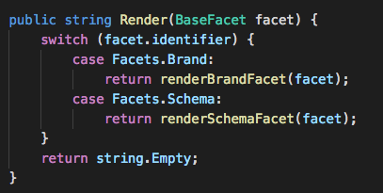
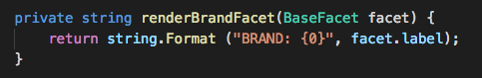
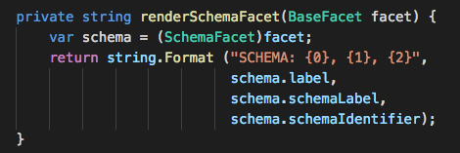
Visitor …the basic way

Slide 41
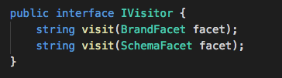
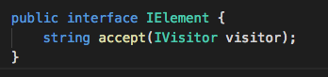
Visitor … think different … improve your code …
Apply the VISTOR pattern to remove conditional code

Slide 42
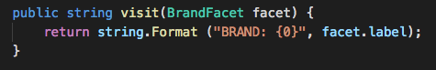
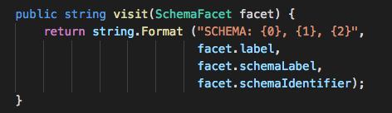
Visitor … think different … improve your code …
Implementing the IVisitor interface …

Slide 43
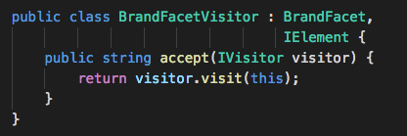

Visitor … think different … improve your code …
Implementing the IElement interface …

Slide 44

Visitor … think different … improve your code …
And finally use them …
Where’s the SWITCH ?

Slide 45
NoIF
Let programming language functional extension help you
Use a dictionary of objects when possible
Replace conditional with polymorphism
Use dependency injection to resolve the right concrete instance instead of passing flags
Replace conditional with visitor (http://www.refactoring.com/catalog/replaceConditionalWithVisitor.html)

Slide 46
Notes:
YNSDK iOS Mobile framework

Slide 47



Notes:
YNSDK iOS Mobile framework

Slide 48

Notes:
YNSDK iOS Mobile framework

